Slide 1

Integrals Part 3
RCET 0264 Introductory Calculus
Tim Leishman

Slide 2

Integrals Part 3
Integrals:
Also know as Antiderivative.
Purpose is to find the Function of a given differential (or derivative).
Given the known rate of change, $\frac{dy}{dx}$, find the function $y$.
$\int{x^{n}dx}=\frac{x^{n+1}}{n+1}+C$

Slide 3
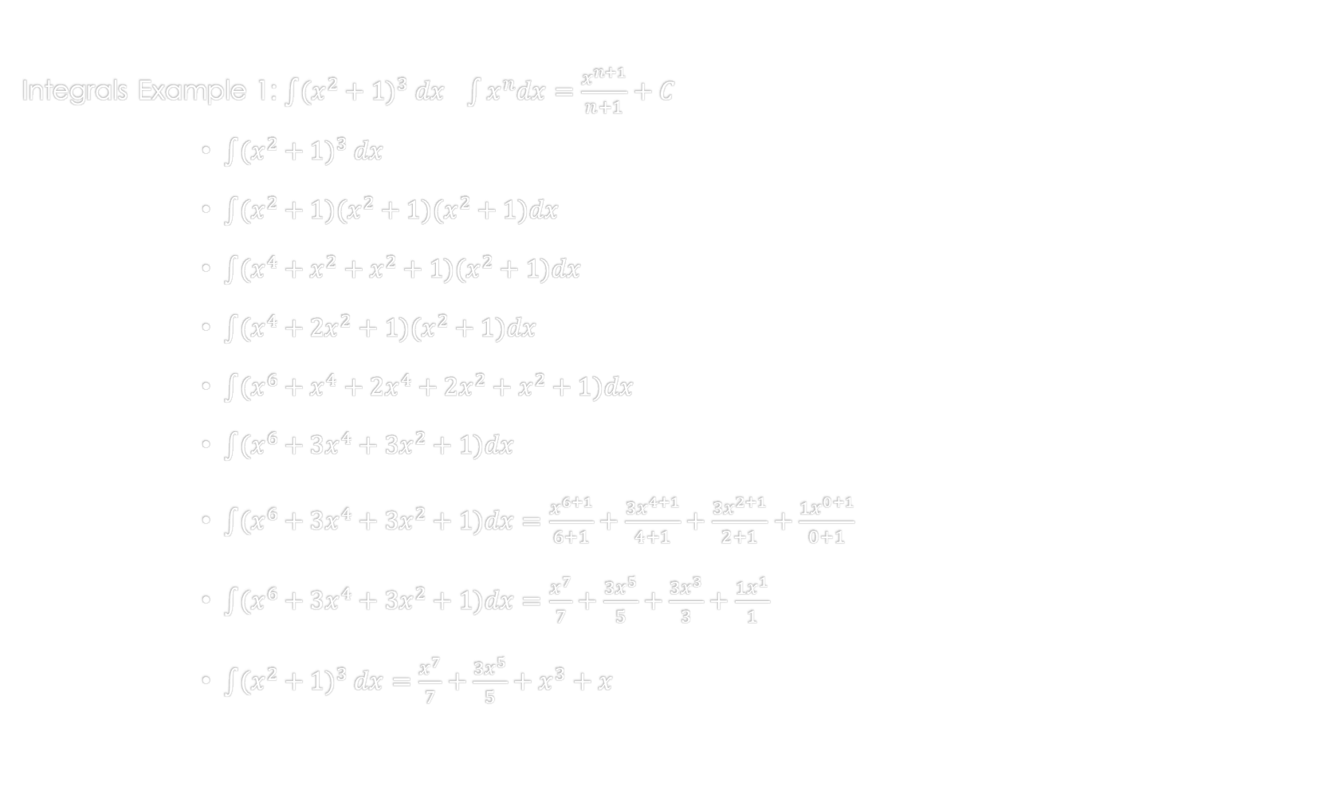
Integrals Part 3
Integrals Example 1: $\int{{(x^{2}+1)}^{3} dx}$ $\int{x^{n}dx}=\frac{x^{n+1}}{n+1}+C$
$\int{{(x^{2}+1)}^{3} dx}$
$\int{(x^{2}+1)(x^{2}+1)(x^{2}+1)dx}$
$\int{(x^{4}+x^{2}+x^{2}+1)(x^{2}+1)dx}$
$\int{(x^{4}+{2x}^{2}+1)(x^{2}+1)dx}$
$\int{(x^{6}+x^{4}+2x^{4}+2x^{2}+x^{2}+1)dx}$
$\int{(x^{6}+3x^{4}+3x^{2}+1)dx}$
$\int{(x^{6}+3x^{4}+3x^{2}+1)dx}=\frac{x^{6+1}}{6+1}+\frac{{3x}^{4+1}}{4+1}+\frac{{3x}^{2+1}}{2+1}+\frac{1x^{0+1}}{0+1}$
$\int{(x^{6}+3x^{4}+3x^{2}+1)dx}=\frac{x^{7}}{7}+\frac{{3x}^{5}}{5}+\frac{{3x}^{3}}{3}+\frac{1x^{1}}{1}$
$\int{{(x^{2}+1)}^{3} dx}=\frac{x^{7}}{7}+\frac{{3x}^{5}}{5}+x^{3}+x$

Slide 4
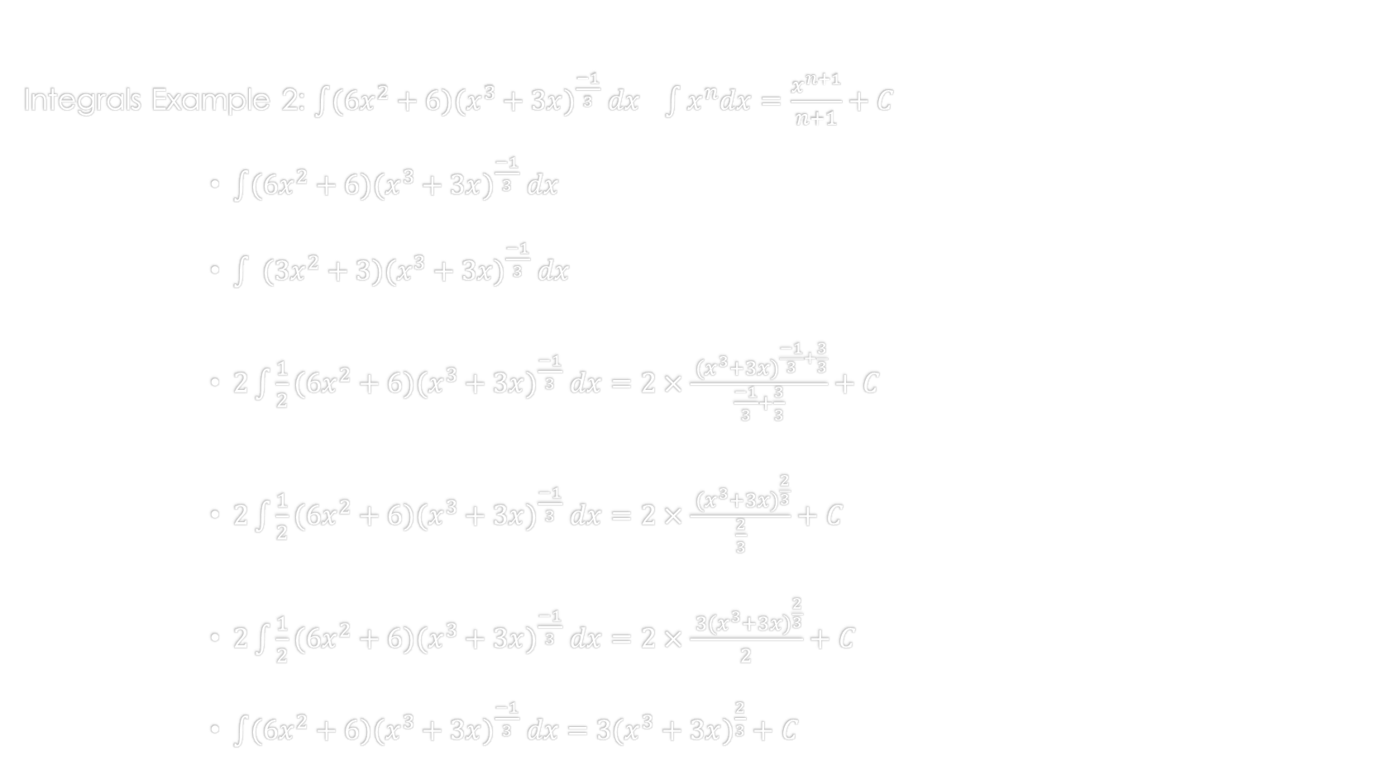
Integrals Part 3
Integrals Example 2: $\int{(6{x^{2}+6)(x^{3}+3x)}^{\frac{−1}{3}} dx}$ $\int{x^{n}dx}=\frac{x^{n+1}}{n+1}+C$
$\int{(6{x^{2}+6)(x^{3}+3x)}^{\frac{−1}{3}} dx}$
$\int{ ({3x^{2}+3)(x^{3}+3x)}^{\frac{−1}{3}} dx}$
$2\int{\frac{1}{2}(6{x^{2}+6)(x^{3}+3x)}^{\frac{−1}{3}} dx=2×\frac{{ (x^{3}+3x)}^{\frac{−1}{3}+\frac{3}{3}}}{\frac{−1}{3}+\frac{3}{3}}}+C$
$2\int{\frac{1}{2}(6{x^{2}+6)(x^{3}+3x)}^{\frac{−1}{3}} dx=2×\frac{{ (x^{3}+3x)}^{\frac{2}{3}}}{\frac{2}{3}}}+C$
$2\int{\frac{1}{2}(6{x^{2}+6)(x^{3}+3x)}^{\frac{−1}{3}} dx=2×\frac{{ 3(x^{3}+3x)}^{\frac{2}{3}}}{2}}+C$
$\int{(6{x^{2}+6)(x^{3}+3x)}^{\frac{−1}{3}} dx={ 3(x^{3}+3x)}^{\frac{2}{3}}}+C$

Slide 5
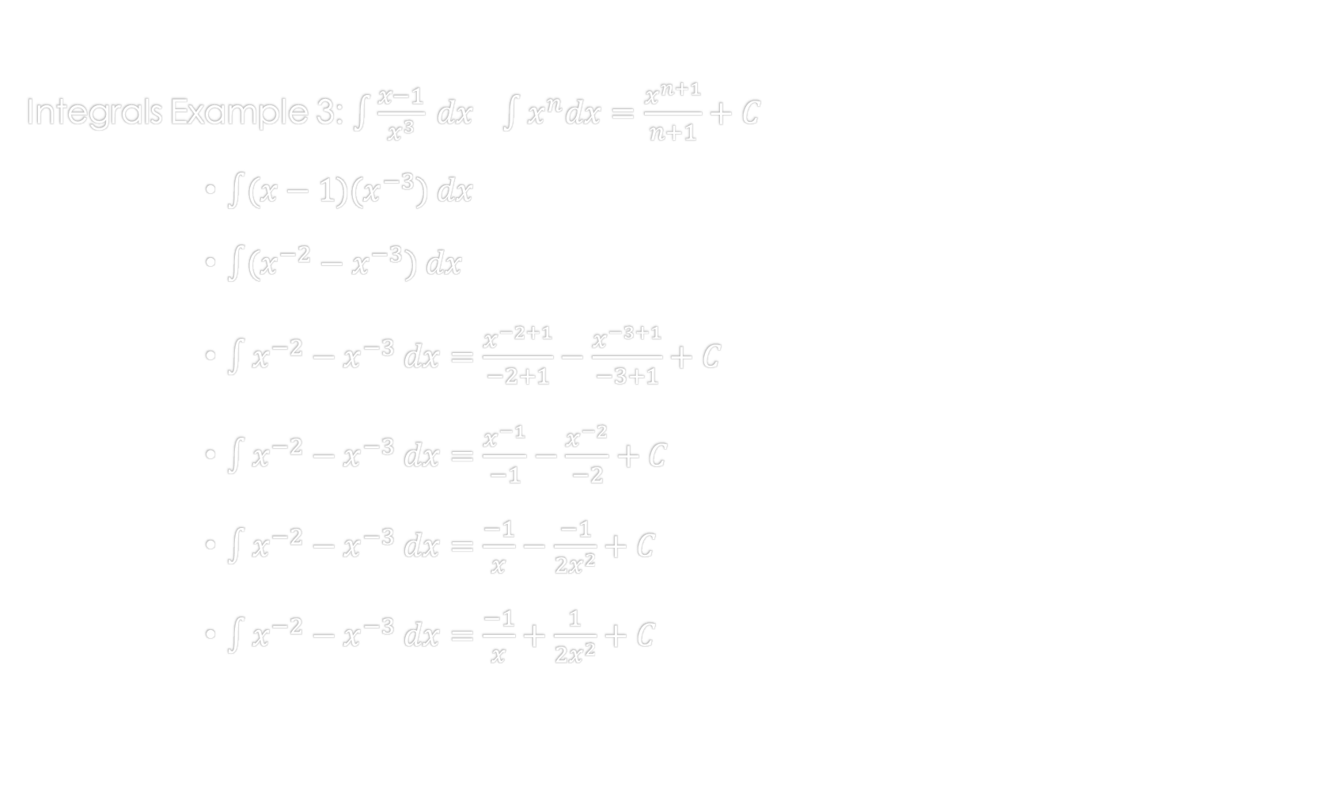
Integrals Part 3
Integrals Example 3: $\int{\frac{x−1}{x^{3}} dx}$ $\int{x^{n}dx}=\frac{x^{n+1}}{n+1}+C$
$\int{(x−1)(x^{−3}) dx}$
$\int{(x^{−2}−x^{−3}) dx}$
$\int{x^{−2}−x^{−3} dx}=\frac{x^{−2+1}}{−2+1}−\frac{x^{−3+1}}{−3+1}+C$
$\int{x^{−2}−x^{−3} dx}=\frac{x^{−1}}{−1}−\frac{x^{−2}}{−2}+C$
$\int{x^{−2}−x^{−3} dx}=\frac{−1}{x}−\frac{−1}{2x^{2}}+C$
$\int{x^{−2}−x^{−3} dx}=\frac{−1}{x}+\frac{1}{2x^{2}}+C$

Slide 6
References:
Ewen, D., Gary, J. S., & Trefzger, J. E. (2005). Technical calculus. Upper Saddle River, NJ: Pearson/Prentice Hall.
Richmond, A. E., & Hecht, G. W. (1995). Calculus for electronics. New York: Glence.

